Slide 1
Project Presentation of Back End Engineering Project (BEE) (22CS026)
On
Booking Management System
Akhil Acharya 2210991216
Amber Dhama 2210991251
Ananya Mahajan 2210991260
Ashi Srivastava 2210991396
Supervised By
Mr. Reshab Kumar
Department of Computer Science and Engineering,
Chitkara University, Punjab

Slide 2
Abstract
This report discusses the development of a comprehensive booking system , WorkWave tailored for small businesses. The system allows users to browse and book services, communicate in real-time with businesses, and receive booking confirmations via email and SMS. The system also includes a sales tracker for businesses to monitor their performance.
This project focuses on the development of a scalable and flexible booking system using microservices architecture. The system is designed to handle bookings across various domains, such as travel, hospitality, and event management. By leveraging microservices, the system ensures modularity, allowing each service to be developed, deployed, and scaled independently. This approach enhances fault tolerance, facilitates continuous integration and deployment (CI/CD), and improves overall system performance and maintainability.
2

Slide 3
Keywords
Booking System
Small Business
Real-Time-Chat
Email-Integration
Sales Tracker
3

Slide 4
Introduction
2.1 Background
Small businesses often struggle to manage bookings, customer communication, and sales tracking efficiently. In an increasingly digital world, a streamlined solution that integrates these functions is essential for maintaining competitiveness.
2.2 Problem Statement
Businesses of all sizes, from small local services to large enterprises, face challenges in managing bookings, customer communications, and sales tracking. While small businesses often struggle with basic scheduling and customer management due to limited resources . The lack of a scalable, flexible, and user-friendly booking system hinders businesses from optimizing their operations and providing a seamless customer experience. This project aims to develop a robust booking system that caters to businesses of all scalability, offering features like real-time communication, integrated notifications, and comprehensive sales tracking to meet diverse operational needs.
4

Slide 5
Software and Hardware Requirement Specification
3.1 Methods
The development methodology follows Agile principles, focusing on iterative development and continuous feedback. The project will be divided into sprints, each delivering key components of the system
3.2 Programming/Working Environment
Programming Language: JavaScript (React for frontend, Node.js for backend)
Database: MongoDB (NoSQL database)
Communication: WebSocket (for chat functionality)Email/SMS
Integration: Twilio (for SMS) and Node mailer (for email notifications)
3.3 Requirements to run the application
Operating System: Windows 10/Linux/MacOS
RAM: Minimum 8GB
Processor: Intel i5 or equivalent Software
Dependencies: Node.js, MongoDB , Express
Browser: Latest versions of Chrome, Firefox, or Safari

Slide 6
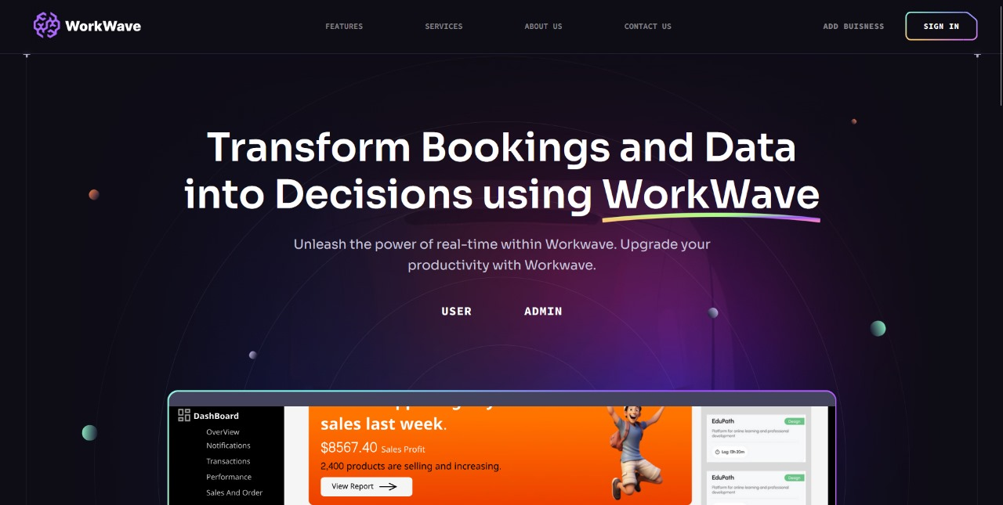
Program’s Structure Analyzing and GUI Constructing

Slide 7
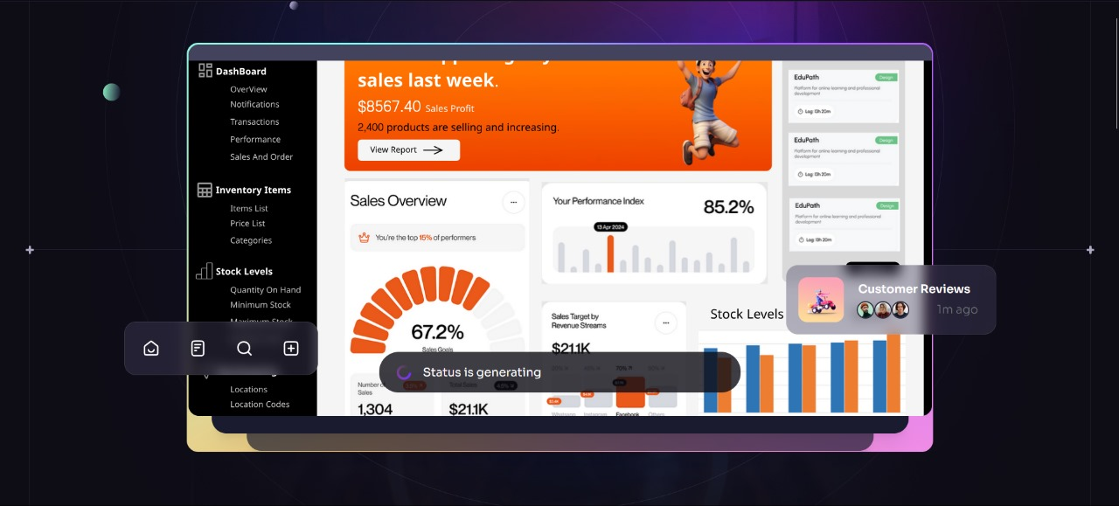

Slide 8
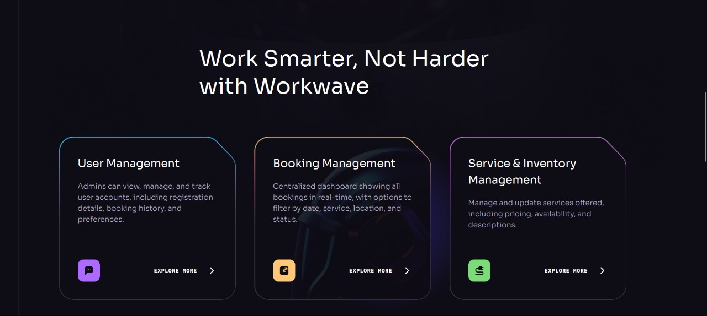

Slide 9
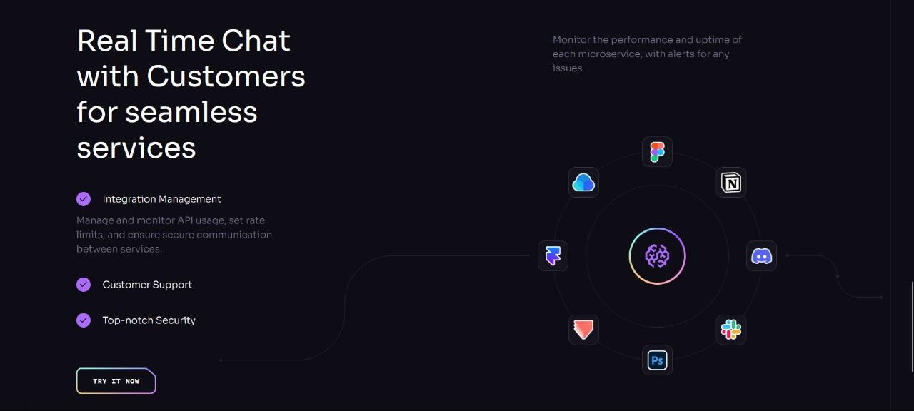

Slide 10
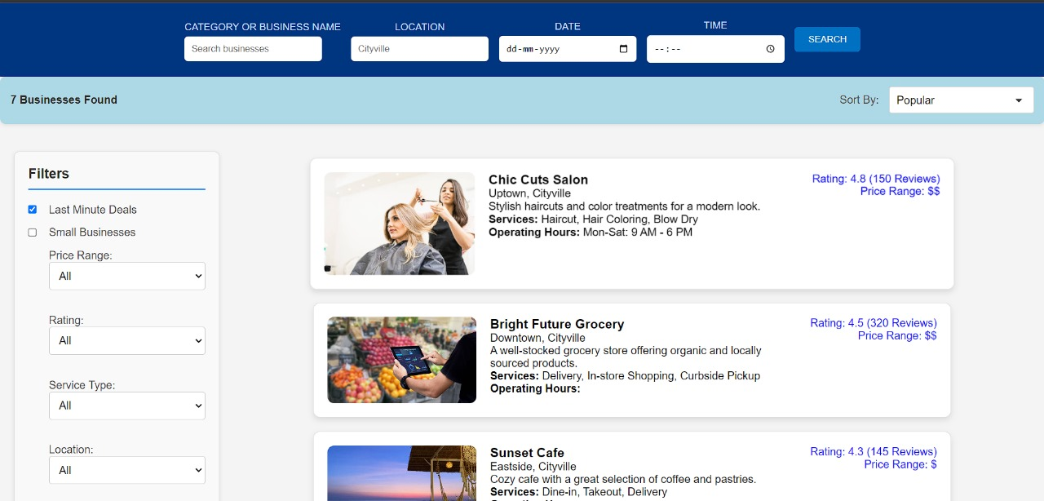

Slide 11
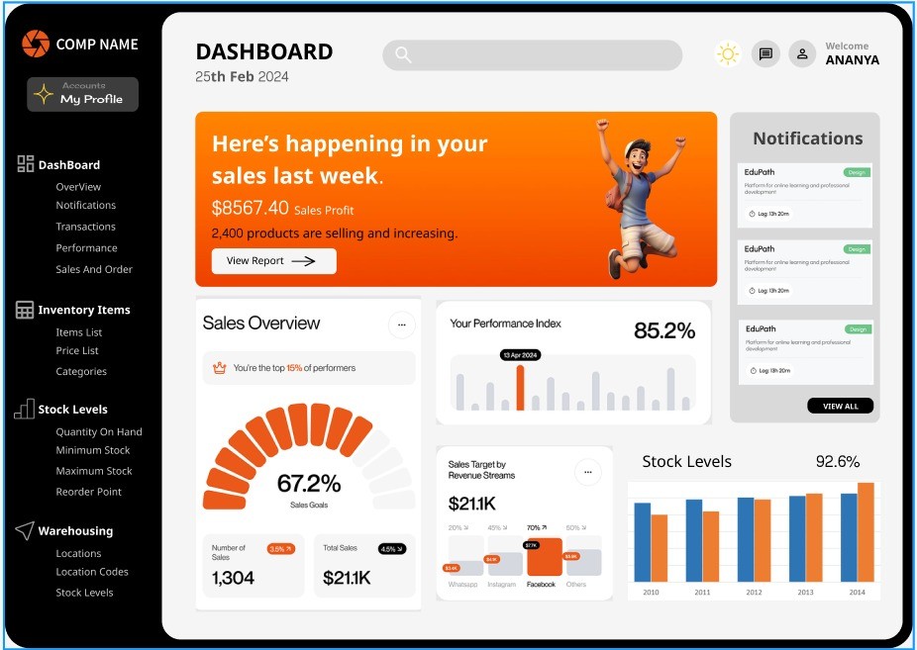

Slide 12
TECHNOLOGIES AND TOOLS
WorkWave development will make use of a variety of tools and technology, such as:
MERN Stack:
MongoDB: Scalable data management and storage in a NoSQL database.
A web application framework for creating reliable backend services is called Express.js.
React is a JavaScript package designed for creating interactive and dynamic user interfaces.
Node.js is a server-side development environment for JavaScript.
Extra Technology
Nodemailer - Email notification system.
Stripe / Paypal Api – Payment gateway integration which enables secure payment processing
Socket.io – used for real time communication b/w user and admin

Slide 13
Conclusion
The development and implementation of a booking management system provide a robust solution for managing reservations, services, and customer interactions efficiently. By integrating a well-designed database, intuitive user interface, and secure payment processing, the system enhances both the user experience and operational effectiveness.
Key outcomes include:
Improved Efficiency: The system automates the booking process, reducing manual errors and administrative overhead. It streamlines operations, allowing businesses to handle more bookings with less effort.
2.Enhanced User Experience: Users benefit from an easy-to-navigate platform that allows them to book services quickly, receive instant confirmations, and manage their bookings seamlessly. The system also supports personalized experiences and notifications.
3.Scalability and Flexibility: The booking management system is designed to scale with growing business needs, accommodating more users, services, and locations. It is also flexible enough to adapt to various industries, from hospitality and healthcare to events and transportation.

Slide 14
4. Data-Driven Decision Making: The system's reporting and analytics capabilities provide valuable insights into customer behavior, booking trends, and financial performance. Businesses can use this data to make informed decisions, optimize services, and increase revenue.
5. Security and Compliance: With built-in security features, including encryption and role-based access control, the system ensures that sensitive data is protected, and transactions are secure. Compliance with data protection regulations is also a priority.
In conclusion, the booking management system is a vital tool for businesses looking to optimize their operations, improve customer satisfaction, and stay competitive in a digital-first world. As technology evolves, the system can be further enhanced with emerging technologies like AI, machine learning, and IoT, ensuring it remains relevant and valuable in the future.

Slide 15
Future Scope
The future scope of booking management systems is promising, with several key areas for growth and innovation. These systems are evolving to meet the changing needs of businesses and customers alike, offering more sophisticated features and improved user experiences. Here are some potential developments in the field:
AI-Driven Analytics: Incorporate AI and machine learning algorithms to analyze booking patterns, customer behavior, and sales trends, providing actionable insights for businesses.
Multi-Language Support: Expand the system’s reach by adding multi-language support, allowing businesses to cater to a global customer base.
Integration with ERP Systems: Enable seamless integration with Enterprise Resource Planning (ERP) systems to streamline business operations beyond booking management.

Slide 16
Advanced Customization: Offer more customization options for businesses, including personalized booking workflows, custom branding, and tailored customer communication.
Mobile Application Development: Develop a mobile application to complement the web platform, allowing business owners and customers to manage and make bookings on the go.
Blockchain Integration: Explore the potential for integrating blockchain technology for secure, transparent transactions and data management.

Slide 17
Bibliography/References
MongoDB Documentation. "NoSQL Database for Modern Applications." MongoDB, 2024. https://www.mongodb.com
React.js Official Documentation. "A JavaScript Library for Building User Interfaces." Meta, 2024. https://reactjs.org
Node.js Documentation. "JavaScript Runtime Built on Chrome's V8 JavaScript Engine." OpenJS Foundation, 2024. https://nodejs.org
Twilio API Documentation. "Cloud Communications Platform." Twilio, 2024. https://www.twilio.com/docs
SendGrid API Documentation. "Email Delivery Service." SendGrid, 2024. https://sendgrid.com/docs
Docker Documentation. "Docker: Empowering App Development for Any Infrastructure." Docker, 2024. https://docs.docker.com
AWS Documentation. "Amazon Web Services: Cloud Computing Services." AWS, 2024. https://aws.amazon.com/documentation

Slide 18
Thank You
18

